Slide 1
THEORIES OF SELLING

Slide 2
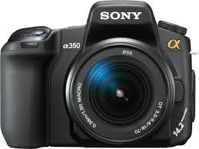




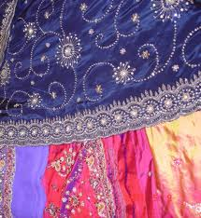
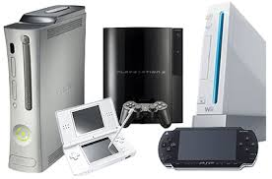
SOME PRODUCTS

Slide 3
THEORIES OF SELLING
Selling is considered as an art by some and a science by others.
This has produced two contrasting approaches to the theory of selling.

Slide 4
Four Theories of Selling
AIDAS
“Right set of circumstances”
“Buying Formula”
“Behavioral Equation”

Slide 5
AIDAS and “Right Set Of Circumstances” are seller oriented theories.
“Buying Formula” theory of selling is Buyer oriented.
The “Behavioral Equation” theory emphasizes the buyer’s decision process but also takes the salesperson’s influence process into account.

Slide 6
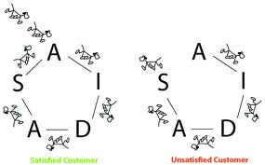
AIDAS

Slide 7
AIDAS theory of selling
Developed by William James in 1908
Focused on mental state of consumer
Sales presentation must lead the prospects through these state of mind

Slide 8
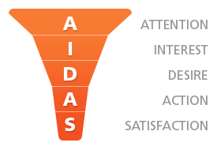
AIDAS theory of selling
A-Securing attention.
I-Gaining Interest.
D-Kindling/Arousing desire.
A-Inducing Action.
S-Building Satisfaction.

Slide 9


Securing attention:
In order to put the prospect into a receptive state of mind, the first few minutes of the interview are crucial.

Slide 10

Gaining Interest:
Some sales people develop contagious enthusiasm for the product or a sample.

Slide 11


Kindling Desire:
Obstacles must be faced and ways found to get around them. Objections need answering to the prospects satisfaction.
Time is saved, and the chance of making a sale improved if objections are anticipated and answered before the prospects raises them

Slide 12


Inducing Action:
Experienced sales personnel do not close until the prospect is fully convinced of the merits of the proposition.

Slide 13

Building Satisfaction:
The sales person should reassure the customer that his buying decision is correct and that sales person merely helped in deciding.

Slide 14
“Right Set of Circumstances” Theory Of Selling
Summed up as “Everything Was Right for The Sale.”
Situation Response Theory
This Theory holds that the particular circumstances prevailing in a given selling situation cause the prospect in a predictable way.
The more skilled the salesperson is in handling the set of circumstances, the more predictable is the response.

Slide 15
“Right Set of Circumstances” Theory Of Selling
The set of circumstances includes factors external & internal to the prospect.
The salesperson and the remark are external factors.
Proponents of these theory tends to stress external factors and the expense of internal factors.
This is a seller oriented theory: it stresses the importance of the salesperson controlling the situation.

Slide 16
The ‘’Buying Formula’’ Theory
The name ‘’buying formula’’ has been given by E.K. Strong.
It emphasizes the buyer’s side of the buyer-seller dyad.

Slide 17

Reduced to its simplest form, the mental processes involved in a purchase are
Need(or problem)
Solution
Purchase

Slide 18

Need
Solution
Purchase
Satisfaction
After adding the fourth element, it becomes

Slide 19
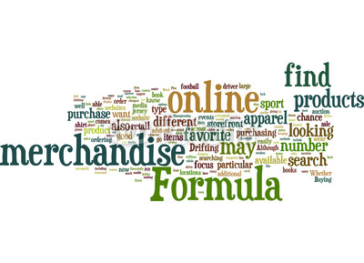
Need
Product/Service and trade name
Purchase
Satisfaction/Dissatisfaction
After modification in the solution and satisfaction, the buying formula becomes

Slide 20
Need
Product/Service and trade name
Purchase
Satisfaction/Dissatisfaction
After adding adequacy and pleasant feelings, it becomes
Pleasant feelings
Adequacy

Slide 21
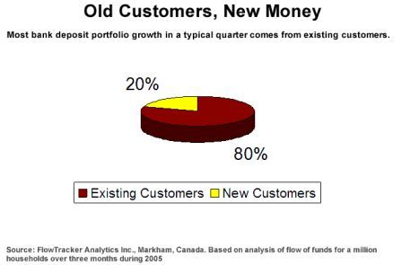
if sales to new prospects are desired, every element in the formula should be presented.
developing new uses is comparable to selling to new prospects.

Slide 22

4: BEHAVIORAL EQUATION THEORY

Slide 23
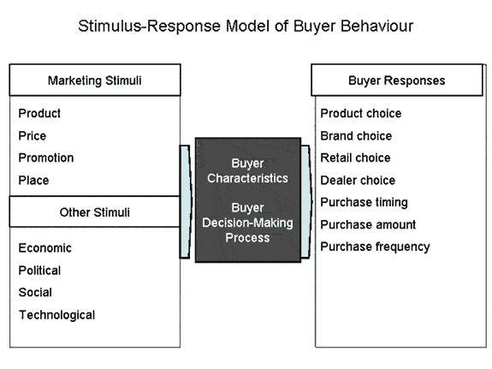
Developed using stimuli-response model.
Sophisticated and advanced version of the “Right set of circumstances” theory.

Slide 24
Requires 4 essential elements-
1: Drive-A strong internal stimulus.
Innate
Learned
2: Cues-Weak stimuli when the buyers respond.
Triggering
Non-Triggering (specific product-eg. special discounts)

Slide 25

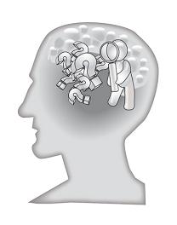
3: Response- What does the buyer do?
4: Reinforcement- Event that strengthens the buyer’s response tendency.

Slide 26
Equation:
B=P*D*K*V
B=Response
P=Predisposition (inward response tendency)
D=Present drive level
K=Incentive potential
V=Intensity of all cues

Slide 27
When a product’s potential satisfaction to the buyer (K) yields rewards, reinforcement occurs.
When P is positive, K is automatically active.
When P and K are positive, customers are more loyal to the product.

Slide 28


